Slide 1

Gun Gun Burmawan
Improving the Quality of GrowiaShop: Evaluation & Recommendations

Slide 2
Overview of My Manual QA Tester Portfolio
My name is Gun Gun Burmawan, a certified Manual QA Tester from Growia Education, with a strong dedication to ensuring software quality and optimal performance. With a professional background as an entrepreneur, I bring a keen analytical mindset and strong attention to detail to the field of quality assurance. I have a comprehensive understanding of the Software Development Life Cycle (SDLC), along with hands-on experience in developing test plans, designing detailed test cases, and executing both functional and non-functional testing. I am proficient in identifying bugs, documenting defects, and collaborating effectively with development teams to ensure the timely resolution of issues. My expertise includes regression testing. I am committed to contributing to the delivery of high-quality software solutions, enhancing user satisfaction, and supporting organizational objectives through robust quality assurance practices.

Slide 3
About Me
I am a certified Manual Quality Assurance professional from Growia Education, equipped with solid competencies in test planning, test case design, and defect tracking. My prior experience as an entrepreneur has provided a distinctive perspective and broadened my approach to quality assurance practices. I am currently seeking opportunities to advance my career as a Manual QA Tester and contribute meaningfully to the delivery of reliable and high-quality software solutions.

Slide 4
Key Skills
● Test Planning: Formulating comprehensive test plans that define testing strategies, scope, required resources, and timelines to ensure thorough and systematic test coverage.
● Test Case Design: Developing well-structured and effective test cases that address both functional and non-functional requirements to validate system performance and reliability.
● Defect Tracking: Accurately identifying, documenting, and managing software defects using tools such as JIRA, while maintaining effective collaboration with development teams to ensure timely resolution.
● Functional Testing: Performing structured functional testing to ensure that software applications operate in accordance with defined requirements and deliver the intended outcomes.
● Regression Testing: Carrying out comprehensive regression testing to validate that recent code modifications do not negatively impact existing system functionalities.

Slide 5
Experience and Project
In this portfolio, I present the projects completed during my studies at Growia, which include developing comprehensive test plans, designing detailed test cases, and performing various testing types such as functional and regression testing. These projects showcase my capability to ensure software quality and functionality, identify defects, and contribute to enhancing the overall user experience.

Slide 6
Improving the Quality of GrowiaShop: Evaluation & Recommendations GROWIA EDUCATION, APRIL 2025
Analysis of Test Results and Recommendations for Improvement

Slide 7
INTRODUCTION
Project Title: Improving the Quality of GrowiaShop: Evaluation & Recommendations
Project Duration: February 11, 2025 - February 24, 2024 (2-weeks)
Role: Manual QA Student (Individual Project)
Objectives:
○ Ensuring the reliability of new features in GrowiaShop.
○ Identifying and reporting bugs found during testing.
○ Providing improvement recommendations to enhance system quality.

Slide 8
INTRODUCTION2
• Technology and Testing Tools:
Microsoft Excel was used for test case management, including the creation and organization of test plans and test cases.
JIRA was utilized as the defect tracking system to log and manage bugs throughout the testing process.
Microsoft Excel was also used for documentation and reporting, including test result summaries and improvement recommendations.
PowerPoint was employed as a presentation tool to visually communicate testing results and findings to stakeholders and developers.

Slide 9
Testing Process
1. Test Planning:
The testing process began with identifying the most critical areas of the GrowiaShop application,
particularly newly added features such as checkout functionality, payment methods, and shopping cart
behavior. The testing was categorized as functional testing across multiple levels, including component
integration testing, system testing, and system integration testing, with the objective of ensuring each
feature works as intended and integrates properly within the overall system.
2. Test Case Design:
A total of 65 test cases were designed to validate various user scenarios, focusing on key functionalities
such as user login, product selection, checkout process using credit card payment, and transaction
history. Each test case included both positive scenarios (e.g., valid payment details) and negative
scenarios (e.g., invalid or missing inputs). Specific attention was given to test coverage for critical paths
like order processing and payment confirmation.

Slide 10
Testing Process2
3. Test Execution:
The test cases were executed manually using a combination of scripted testing and exploratory testing.
During the execution, 28 bugs were identified. One of the most critical findings (BUG-017) was a credit
card payment failure, where the system failed to confirm the transaction despite valid card input,
showing only a loading spinner without any order confirmation or error message.
4. Defect Reporting:
All defects were tracked in JIRA, documented with detailed descriptions, severity, priority, reproduction
steps, and visual evidence. Critical bugs such as BUG-017 (credit card payment failure) were reported
with high priority and severity. Reports were communicated to the development team via JIRA tickets
and supported by test summary reports in Excel and PowerPoint presentations for stakeholder meetings.

Slide 11
Testing Process3
5. Summary and Recommendations:
- Immediate resolution of high-impact bugs, especially related to checkout functionality, is
recommended.
- After bug fixes, regression testing should be performed to ensure the stability of the system.
- Continuous test planning and structured documentation are essential to maintain quality as GrowiaShop
evolves.

Slide 12
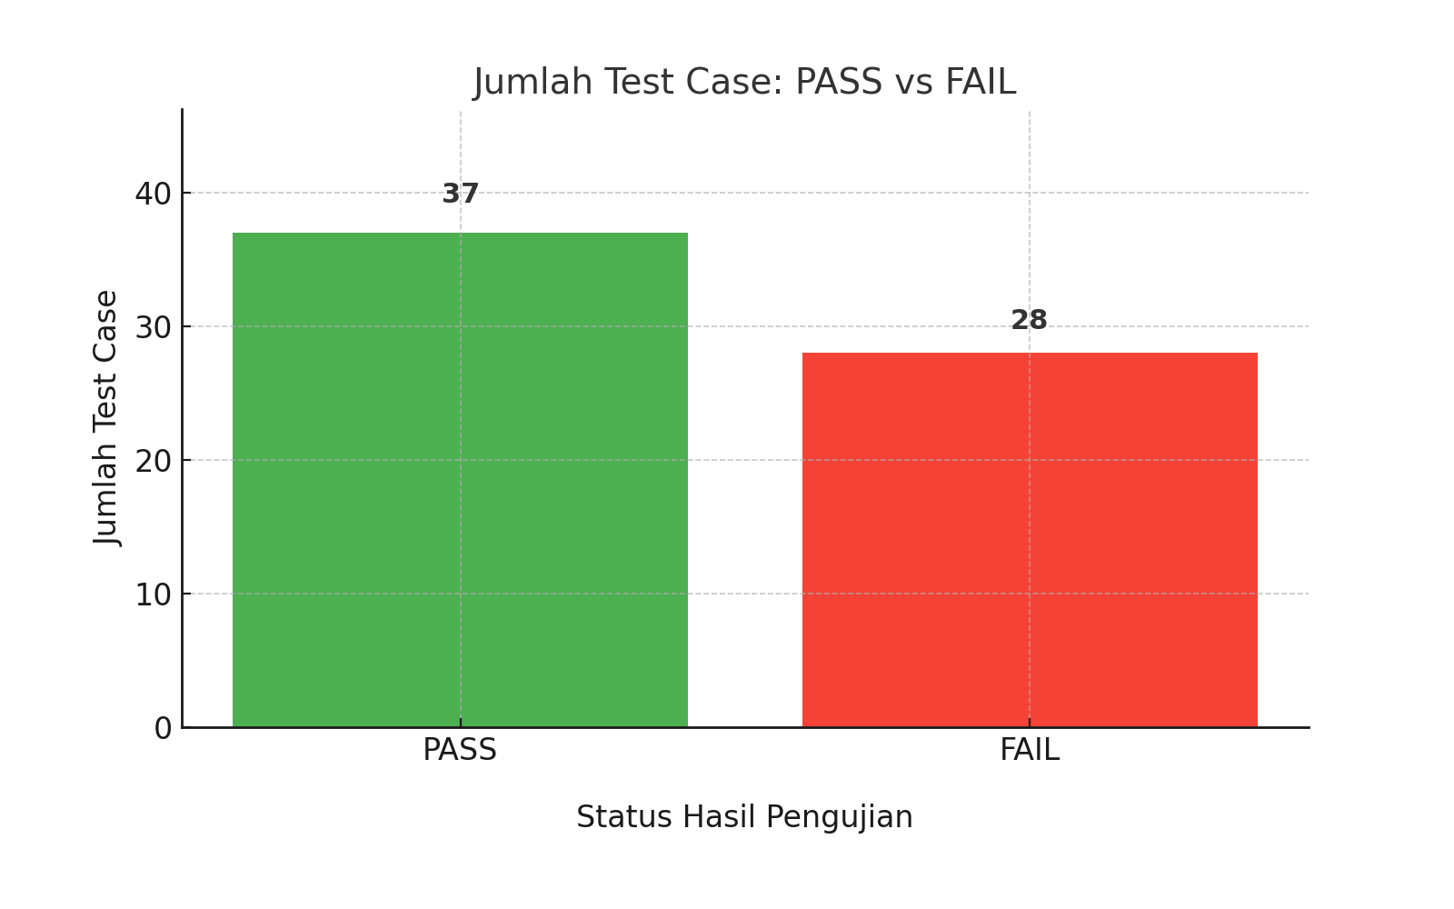
Supporting evidences
Testing Summary Illustrations

Slide 13
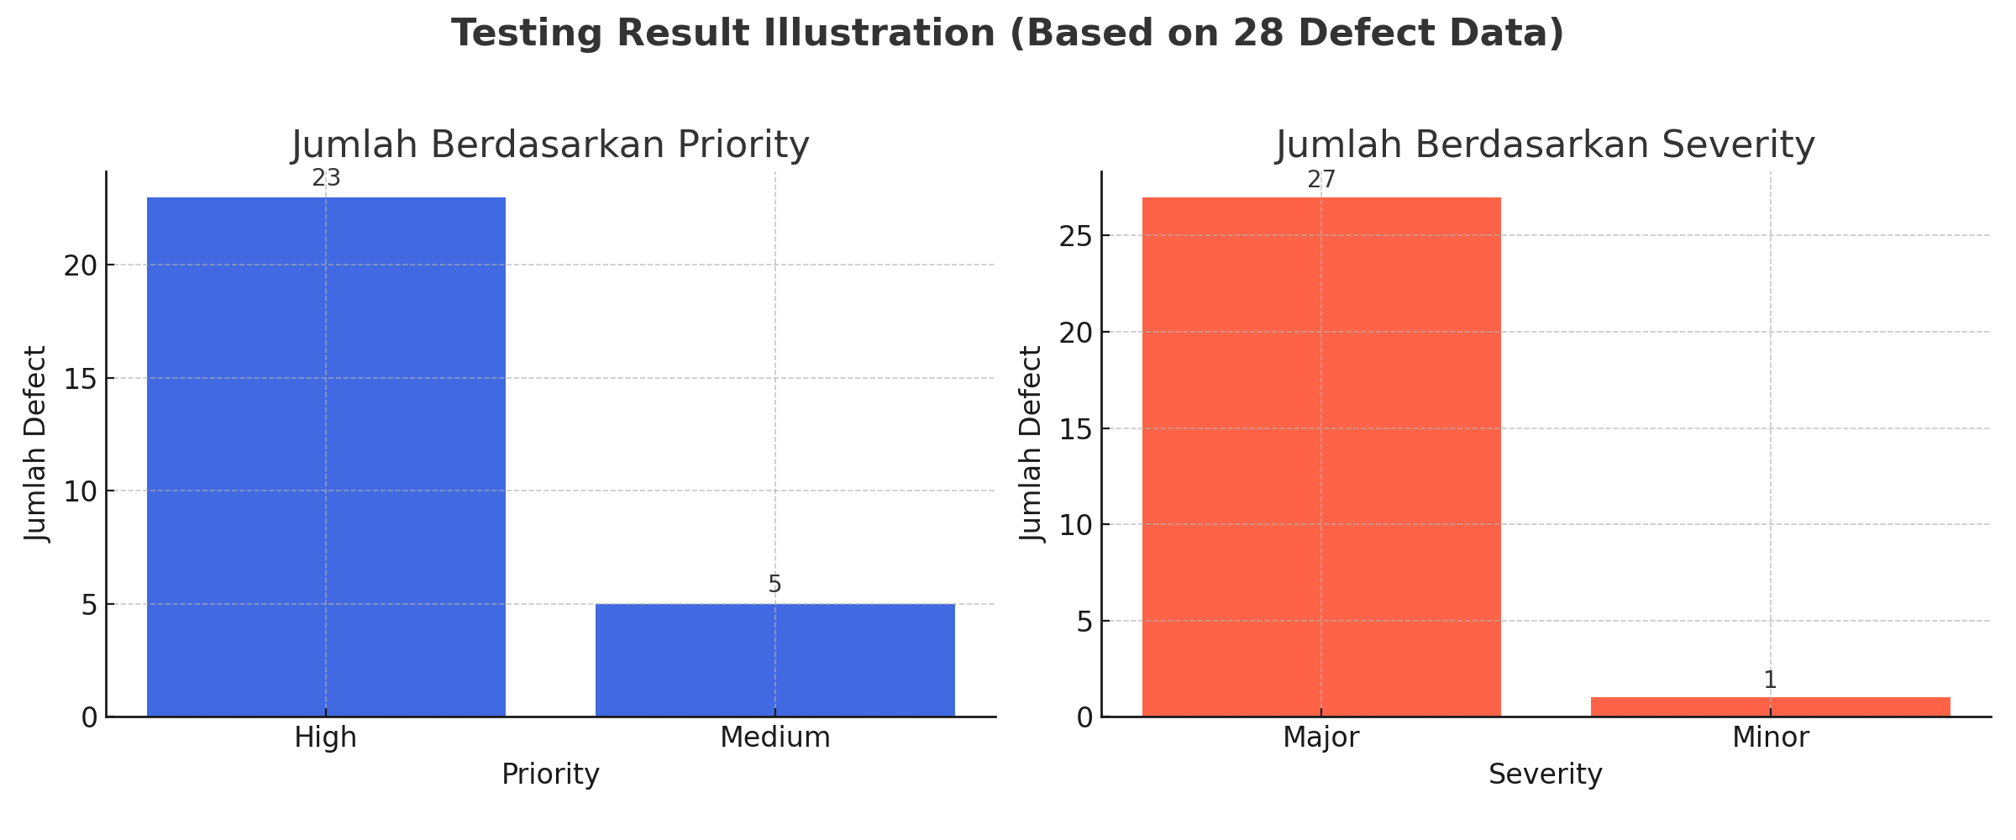
Supporting evidences2
Testing Result Illustrations

Slide 14
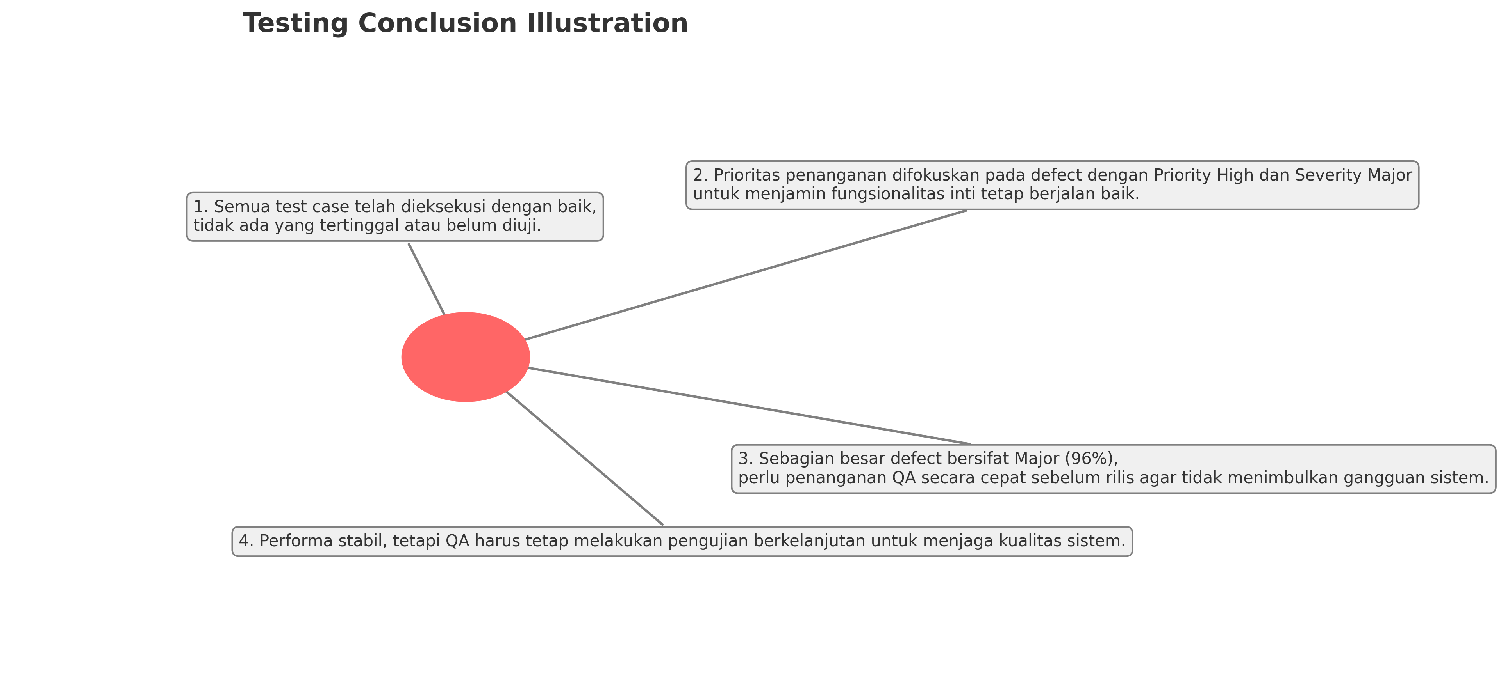
Supporting evidences3
Testing Conclusion Illustrations

Slide 15
Challenges
1. Challenges Faced
During software testing, Quality Assurance (QA) teams often encounter various technical and functional challenges that must be carefully identified. In this case, two major challenges were observed:
SQL Injection on Login Form This is one of the most dangerous types of security vulnerabilities. When users are able to inject SQL code into the login form, they may gain unauthorized access to other users' data or even the entire system. This challenge highlights the importance of security testing in the QA process.
Issues in the Shopping Cart Feature There were problems where users could:
Improperly remove items from the cart (e.g., items still appeared even after being deleted).
Proceed with purchases without logging in first, which could lead to bugs in user session validation.
This issue falls under the category of functional defects, as it affects the business flow that does not operate as expected.

Slide 16
Solutions
2. Solutions Implemented
After identifying these challenges, both technical and collaborative solutions were applied:
Implementation of Input Sanitization QA collaborated with the development team to ensure that user inputs in the login form were sanitized so that malicious characters could not be executed as SQL commands. This is a crucial technique to prevent SQL Injection.
Improvement in Session Management Validation Shopping cart issues were addressed by strengthening user session validation. This means the system will verify whether a user is logged in before allowing transactions or modifications to the cart. This reduces transaction errors and improves overall system security.

Slide 17
Conclusions
1. Results: Out of a total of 65 test cases, 37 test cases were marked as Passed, while 28 test cases Failed. None were Blocked or Pending. The comprehensive testing process successfully identified and documented 28 defects, most of which were classified as High Priority and Major Severity. Several critical bugs were discovered, including suboptimal login form validation, errors in item removal without login, session issues and checkout page navigation problems, and the most complex one—Credit Card Checkout Validation.
2. Achievements: I successfully identified and documented defects with high priority (23 bugs) and major severity (27 bugs), which directly impacted user experience and system security. Additionally, my contributions helped the team improve test coverage to 100% of the requirements, and supported system improvements that enhanced overall stability and performance.

Slide 18
Conclusions2
3. Suggestions (from Tester’s Perspective):
1. Improve Connection and Login Validation:
Ensure all critical actions (such as deleting products or proceeding to checkout) can only be performed with a stable
connection and when the user is logged in.
2. Display Clear Error Messages:
In case of interruptions (e.g., lost connection), provide clear and user-friendly error messages to help users understand the issue.
3. Fix Checkout Navigation Flow:
After completing the checkout process, redirect users directly to the confirmation page instead of returning them to the cart.
4. Add Testing for Special Conditions:
Perform testing for edge cases such as disconnected network, opening multiple tabs, or using the system without logging in, to prevent hidden bugs.
5. Ensure User Access Security:
Make sure that only authorized users are able to make data changes or perform transactions.

